Slide 1


From Data to Insights A Hands-on Approach
Data Visualization & Analytics using Excel & Power BI
2-Days Training Program
Let’s get to know you—scan the QR while we wait to begin!

Slide 2
Training Agenda

Slide 3
Day 1 – Advanced Excel & AI Integration
Topics Covered:
Advanced Excel Techniques
Conditional Formatting, Advanced Filtering, Data Validation
Logical & Lookup Functions: IF, VLOOKUP, XLOOKUP, INDEX-MATCH
Array Formulas and Dynamic Arrays
Data Analysis & Automation
PivotTables, Scenario Manager, Data Consolidation
Introduction to Macros and Basic VBA
Excel with AI Integration
Use of AI Features like “Analyze Data” (Ideas), Forecast Sheets
Smart data transformation using Power Query
Data Visualization in Excel
Advanced Charts: Combo Charts, Sparklines
Interactive Dashboards using Slicers and Timelines

Slide 4
Day 2 – Power BI & Excel Integration
Topics Covered:
Introduction to Power BI
Power BI Interface, Data Loading, and Relationships
Basics of DAX for calculated fields
Data Modeling and Measures
Creating Measures and Calculated Columns
Understanding filter context and row context
Report Building and Dashboards
Visualizations, Bookmarks, Tooltips, and Drillthrough
Dashboard storytelling with slicers and interactivity
Excel & Power BI Integration
Connecting Excel to Power BI datasets
Using Excel PivotTables with Power BI data
Exporting Excel visuals into Power BI

Slide 5
Day 1 – Advanced Excel & AI Integration

Slide 6
Introduction – Advanced Excel & AI Integration
Why Advanced Excel Matters
Advanced Excel skills go beyond basic spreadsheets — they enable professionals to manage, analyze, and visualize data efficiently, making informed decisions faster.
The Role of AI in Excel
Excel now integrates intelligent features such as Analyze Data (Ideas) and Forecast Sheets, allowing users to automatically generate insights, trends, and predictions from raw data.
What You Will Learn Today
Master powerful Excel tools like advanced formulas, lookups, and PivotTables.
Use AI features to extract meaningful insights with minimal effort.
Design interactive dashboards using charts, slicers, and timelines.

Slide 7
Revision of Basic Excel Formulas

Slide 8
Examples using Employee Table –
Format Employee details as a Table
Mark Salary column with currency symbol
Mark Age column with as suffix
Exercises on basic, text, date, logical, lookup functions

Slide 9
Formatting as Table in Excel
Why Format Data as a Table?
Automatic Filtering & Sorting: Easy to filter and sort data with built-in dropdowns.
Dynamic Range: Tables automatically expand when you add new rows or columns — no need to update formulas or charts manually.
Structured References: Use intuitive, column-name-based formulas instead of cell addresses (e.g., [Sales] instead of B2:B100).
Consistent Formatting: Applies uniform styles (colors, fonts) that improve readability.
Better Integration: Works seamlessly with PivotTables, Power Query, and Excel’s data tools.
Improved Data Management: Enables features like Total Row, slicers for filtering, and easy data validation.
Summary:
Formatting as a table turns a static range into a dynamic, interactive dataset that simplifies data analysis and enhances workbook functionality.

Slide 10
Data Analytics and Visualization using Excel

Slide 11
What is Data Visualization & Analytics?
📊 Data Visualization
- The art of turning raw data into meaningful insights using charts, graphs, and dashboards.
- Helps identify patterns, trends, and outliers at a glance.
- Examples: Bar charts, Line graphs, Heatmaps, Pie charts, and Interactive dashboards.
📈 Data Analytics
- Uses techniques like descriptive, diagnostic, predictive, and prescriptive analytics.
🔑 Why Does It Matter?
- Makes complex data easy to understand
- Improves decision-making with data-driven insights
- Helps identify trends & anomalies quickly
- Supports better forecasting & business growth
- The process of examining data to find trends, relationships, and actionable insights.

Slide 12
Data Analytics Using Excel
The process of examining, cleaning, transforming, and modeling data to discover useful information, draw conclusions, and support decision-making.
Key Concepts in Data Analytics:
Data Collection: Gathering raw data from various sources.
Data Cleaning: Fixing errors, handling missing values, and formatting data.
Data Transformation: Structuring and reshaping data to fit analysis needs.
Data Analysis: Using statistical and logical techniques to explore data.
Data Visualization: Presenting data insights through charts, tables, and dashboards.
Why Use Excel for Data Analytics?
User-friendly interface with powerful tools.
Supports data cleaning (Power Query), analysis (PivotTables), and visualization (charts).
Widely available and integrates with many data sources.
Enables automation through formulas and macros.
Excel Analytics Workflow:
Import and clean data.
Analyze with formulas and PivotTables.
Visualize insights with charts and dashboards.
Automate repetitive tasks with macros or Power Query.

Slide 13
Data Visualization Using Excel
The process of transforming raw data into visual formats like charts and graphs to easily communicate insights and trends.
Excel Visualization Tools:
Charts: Column, Bar, Line, Pie, Scatter, Area, Combo charts, and more.
Pivot Charts: Dynamic charts linked to PivotTables for interactive analysis.
Conditional Formatting: Highlights data patterns using color scales, data bars, and icons.
Sparklines: Miniature charts within a cell for quick trend spotting.
Data Bars & Colour Scales: Visual cues within data tables.
Benefits of Using Excel for Visualization:
Easy to create and customize visuals.
Helps identify trends, outliers, and relationships quickly.
Supports dynamic, interactive dashboards.
Integrates with data models and formulas for live updates.
Best Practices:
Choose the right chart type for your data.
Keep visuals simple and focused.
Use colors and labels effectively.
Combine multiple visual elements for storytelling.

Slide 14
Introduction to Advanced Excel
Advanced Excel involves powerful tools, functions, and techniques that go beyond basic spreadsheet usage to perform efficient data analysis, automation, and reporting.
Key Uses:
Analyzing large datasets
Automating repetitive tasks with formulas or macros
Creating interactive dashboards
Data cleaning and transformation
How It Saves Time:
Eliminates manual work with smart formulas (e.g., VLOOKUP, IF, INDEX-MATCH)
Automates processes with Flash Fill, PivotTables, and macros
Makes complex tasks easier with AI features like Analyze Data
Popular Features:
PivotTables & Charts – Summarize and visualize data easily
Power Query – Clean, reshape, and merge data from multiple sources
Advanced Functions – SUMIFS, XLOOKUP, TEXT, ARRAYFORMULAS
Macros & VBA – Automate complex workflows
AI Tools – Flash Fill, Analyze Data, Data Types

Slide 15
Array Functions in Excel
Array functions allow you to perform multiple calculations on one or more items in an array (a range of cells, constant values, or results from formulas)
Why Use Them?
Simplify complex tasks like filtering, sorting, and summarizing
Eliminate helper columns
Handle dynamic data ranges efficiently
Key Array Functions –
Note: Modern Excel (365, 2019+) supports dynamic arrays — no need to press Ctrl+Shift+Enter!
Function | Purpose
SEQUENCE | Generates an array of numbers
SORT | Sorts an array
FILTER | Extracts data based on conditions
UNIQUE | Returns distinct values from a range
TEXTSPLIT | Splits text strings into an array
XLOOKUP + ARRAYFORMULA | Perform lookups across ranges dynamically

Slide 16
Examples on Array Functions
Extract names of first five employees
Extract details for these employees
List the names for top 5 employees in ASC order by age
Find names of all employee whose age is 22
Create a pivot table representing Average salary by Age Groups

Slide 17
Power Query Editor
Power Query Editor is a powerful data transformation tool in Excel that helps you:
Connect to multiple data sources (Excel, CSV, web, SQL, etc.)
Clean & transform data (remove rows, split columns, change types)
Automate data prep with a repeatable process
Key Features:
No coding required (but M language under the hood!)
Step-by-step query building
Preview data before applying
Found under: Data > Get & Transform Data > Launch Power Query Editor

Slide 18
Common Tasks in Power Query
Task | How It Helps
Remove columns/rows | Clean unnecessary data
Filter data | Focus on what matters
Split columns | Separate values like "Name, Age"
Merge/Append queries | Combine data from different tables
Change data types | Ensure correct formats for analysis
Create calculated columns | Add logic & business rules
Once done, click Close & Load to push data into Excel. Need updates? Just Refresh — no rework needed!

Slide 19
AI in Excel
Definition
AI in Excel refers to Artificial Intelligence features built into Microsoft Excel that help users analyze, clean, visualize, and understand data faster and smarter.
Key AI-Powered Features
Ideas (Analyze Data): Automatically suggests charts, trends, and summaries from your data.
Data Types: Converts text into rich, linked data (e.g., geography, stocks).
Natural Language Queries: Ask Excel questions like “What’s the average sales?” in plain English.
Smart Fill / Flash Fill: Automatically recognizes and completes patterns in your data.
Copilot in Excel (for Microsoft 365): AI assistant that helps write formulas, create models, and summarize data.
Why It Matters
AI makes Excel more intuitive and powerful, helping users of all skill levels unlock insights and save time on complex tasks.

Slide 20
Data Types in Excel – Add Meaning to Your Text
What Are Data Types?
Built-in Excel feature that converts plain text into linked, structured data.
Supported types include Geography, Stocks, Currency, Food, and more.
Steps to Use Data Types:
Enter your data (e.g., list of countries, companies, stock symbols) in a column.
Select the column or range.
Go to the Data tab on the ribbon.
In the Data Types group, choose:
Geography for country/city names
Stocks for company names or ticker symbols
Excel will convert plain text into linked data types (indicated by a small icon in the cell).
Click the insert button (⨁) that appears next to the cell to pull in related fields:
e.g., for France → Population, Capital, Region, etc.
for a stock → Price, Market Cap, PE Ratio, etc.
What Can You Do with It?
Enrich your spreadsheets with live, structured data.
Create dashboards with up-to-date financial or geographic info.
Use these values in formulas like =[@France].Population
Benefits:
Enables live updates from trusted sources.
Reduces manual entry of related information.
Use structured fields in formulas, dashboards, and analysis.

Slide 21
Smart Fill / Flash Fill
What Is Flash Fill?
Excel’s AI-powered Smart Fill tool that detects and replicates patterns.
Use it to automatically fill in values based on the pattern you create.
How to Use Flash Fill:
In a column, manually enter the desired pattern in the first cell (e.g., extract first names).
Start typing the next value — Excel will suggest the rest.
Press Enter or use Ctrl + E to accept the suggestions.
Example:
Input: "John Smith" → Enter "John" in next column → Flash Fill completes the rest.
Benefits:
Live updates from Data Types.
Pattern recognition with Flash Fill for rapid data cleaning.
Saves time and reduces manual errors.

Slide 22
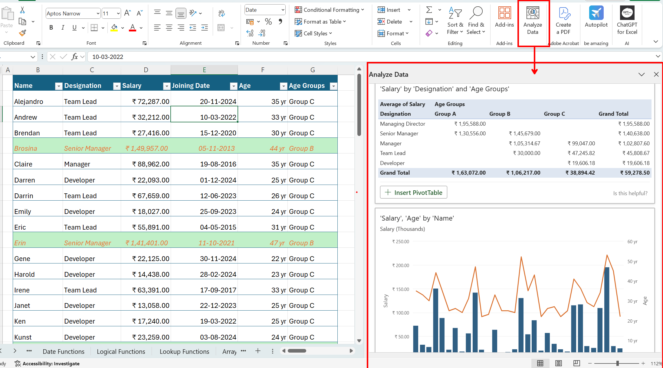
"Ideas" (Analyze Data) in Excel
Requirements:
Microsoft 365 subscription
Data must be in a clean table format (headers + rows of data)
Steps to Use Analyze Data (Ideas):
Select your data in the worksheet (or click inside your data range).
Go to the Home tab on the ribbon.
Click on “Analyze Data” (formerly “Ideas”) at the far right.
The Analyze Data pane opens on the right-hand side.
Excel automatically scans your data and suggests:
Charts (like trends, outliers, categories)
Key insights (averages, totals, comparisons)
Interesting summaries like "X has the highest value in Y"
Click on any suggested chart or insight to add it directly to your sheet.
Tips for Best Results:
Make sure your dataset has clear column headers (no merged cells).
Use consistent data types in each column (e.g., all numbers or all dates).
You can also ask questions in natural language in the "Ask a question" box!

Slide 23
Natural Language Queries in Excel
Requirements:
Excel for Microsoft 365
Your data must be in a well-structured table format with headers
Steps:
Select your data range (make sure it has headers).
Go to the Home tab.
Click on “Analyze Data” on the far right of the ribbon.
The “Analyze Data” pane will open on the right.
In the “Ask a question about your data” box, type a natural language query like:
"What is the average sales?“ | "Total revenue by product?“ | “Show sales trend over time“
Excel will automatically generate a chart, pivot table, or summary answer.
Tips:
Use clear column names to help Excel understand your question better.
You can insert suggested visuals directly into your worksheet.

Slide 24
Examples on “Material Inventory” Table –
Ex. Standardise the units in quantity and in-stock columns to kgs. Use lookup functions and flash fill.
Ex. Generate column – “Total Amount”
Ex. Total number of orders
Ex. Create a table chart to display all the unique vendor names and materials supplied by them in comma separated format.
Ex. Click on “Analyse Data” button to explore the AI suggestion to analyse the data.
Ex. Using the “Ask question about your data” window, get suggestions using following questions using natural language –
Q. Average or Total quantity of each material in stock
Q. Show total quantity supplied by each vendor.
Q. Top Vendors by Quantity Supplied or by number of orders or by in-stock
Q. How many materials were ordered each month?

Slide 25

Introduction to Power BI
A complete reporting solution for data preparation, visualization, distribution, and management.
Scales from simple to complex reports with multiple data sources and models.
Enables creation of interactive, visually appealing reports for teams or entire organizations.
Acts as a powerful analytics and decision-making engine.
Essential for data analysts, but valuable for all data professionals to present insights effectively.

Slide 26
Key Components & Workflow
Power BI has three components: Desktop (development), Service (online management), and Mobile (viewing).
Power BI Desktop is used to connect, model, and visualize data.
Reports are published to the Power BI Service for sharing and collaboration.
Power BI Mobile delivers mobile-optimized report views.
Common workflow: Connect → Transform → Visualize → Publish → Distribute.
Dashboards and apps in the Power BI Service help organize and deliver insights effectively.
Power BI Desktop
Power BI Service
Power BI Mobile

Slide 27
Building Blocks of Power BI
Power BI is built on semantic models and visualizations.
A semantic model includes data sources, transformations, relationships, and calculations.
Use Power BI Desktop to build interactive reports using visuals on the canvas.
Power BI is low-code—simply drag and drop fields to create visuals.
Visuals can be interactive and enable drill through and filtering.
In the Power BI Service, pin visuals to a one-page dashboard for high-level summaries.
Dashboards guide users to deeper insights in the full report.
Visualizations
Reports
Dashboards
Tiles
Datasets

Slide 28
Power BI Installation
Open Microsoft Store (Windows 10/11)
Search for "Power BI Desktop"
Click Install (Free)
Or Download from Official Website
Go to: https://powerbi.microsoft.com
Navigate to Products > Power BI Desktop
Click Download Free
Choose language and download the .exe file
Run the Installer
Double-click the downloaded .exe file
Follow on-screen instructions to install
Launch Power BI Desktop
After installation, open the app from the Start menu
Sign in with your work/school Microsoft account if prompted

Slide 29
Power BI Interface

Slide 30
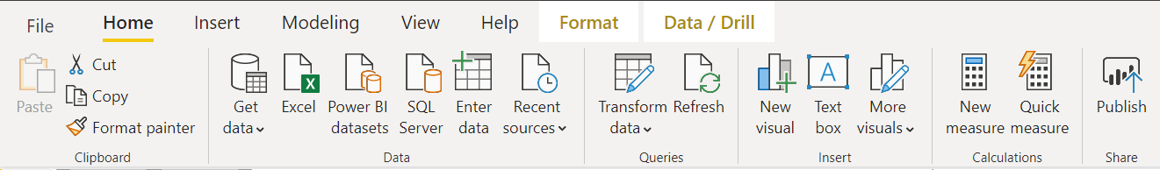
Home Tab - Data Ribbon
Data Connection options
Get Data window, allows to scroll through the list of All data sources

Slide 31
Home Tab - Queries Ribbon
Data Transformation and edit queries
Provides access to Power Query Editor.
It helps shaping data.
Shaping can mean transforming the data, such as renaming columns or tables, removing rows or columns, or changing data types

Slide 32
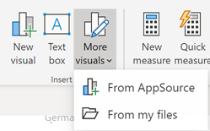
Home Tab - Insert Ribbon
Helps add new visuals
Custom visuals are hosted in AppSource and can be accessed by pressing the “More visuals” dropdown and selecting “From AppSource”

Slide 33
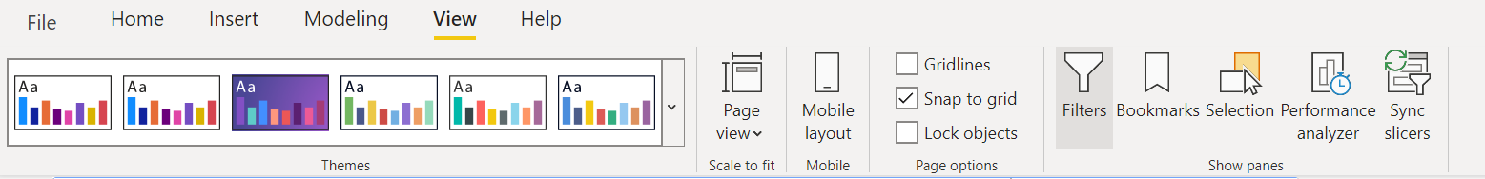
View Tab - Themes Ribbon
Themes ribbon displays themes in a gallery making it more easily to see what colours will be applied to report.
Also allows user to set custom themes

Slide 34
View Tab
Various Page visibility options and hide/show panes on report view tab

Slide 35
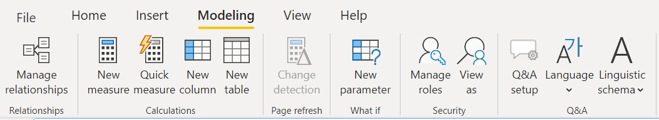
Modelling Tab - Relationships Ribbon
Opens Data Model view
Relationships between tables can be created and managed here.

Slide 36
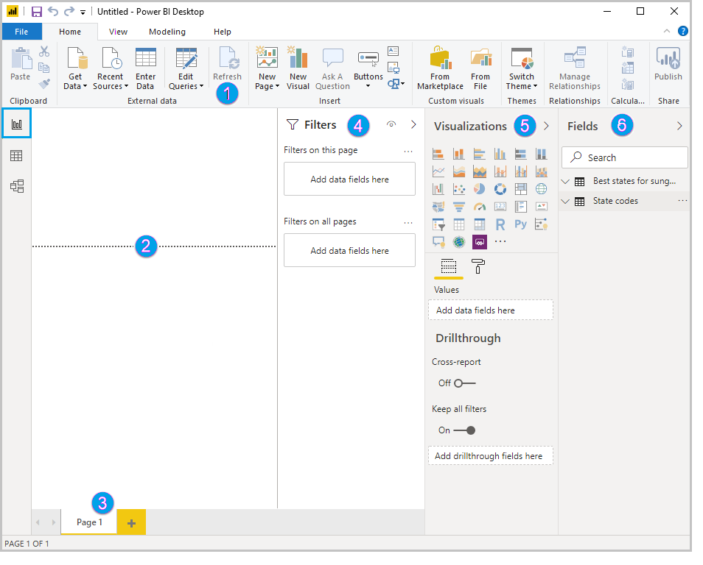
Report View
In Power BI Desktop Report view, user can build visualizations and reports.
The ribbon at the top, which displays common tasks associated with reports and visualizations.
The canvas area in the middle, where visualizations are created and arranged.
The pages tab area at the bottom, which lets you select or add report pages.
The Filters pane, where you can filter data visualizations.
The Visualizations pane, where you can add, change, or customize visualizations, and apply drill through.
The Fields pane, which shows the available fields in your queries. You can drag these fields onto the canvas, the Filters pane, or the Visualizations pane to create or modify visualizations.
1
4
5
6
2
3

Slide 37
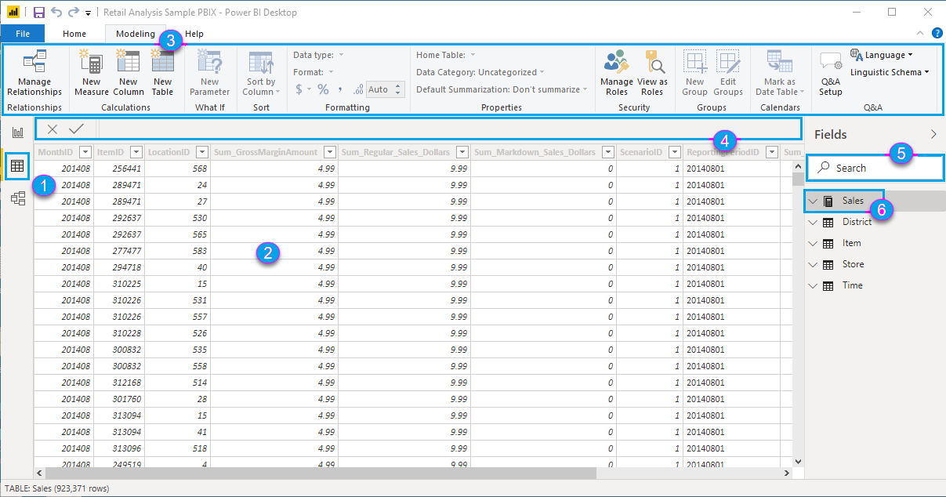
Table View
Data View in Power BI shows a tabular view of your imported data, allowing you to inspect, explore, and verify the dataset before building reports. It helps you see the raw data and understand its structure.
Refer to the figure on the left -
Data view icon - Select this icon to enter Data view.
Data Grid - This area shows the selected table and all columns and rows in it. Columns hidden from Report view are greyed out. Right-click on a column for options.
Modeling ribbon - Tab to manage relationships, create calculations, change data type, format, data category for a column.
Formula bar - Enter Data Analysis Expression (DAX) formulas for Measures and Calculated columns.
Search - Search for a table or column in model.
Fields list - Select a table or column to view in the data grid.

Slide 38
Connecting to Data

Slide 39
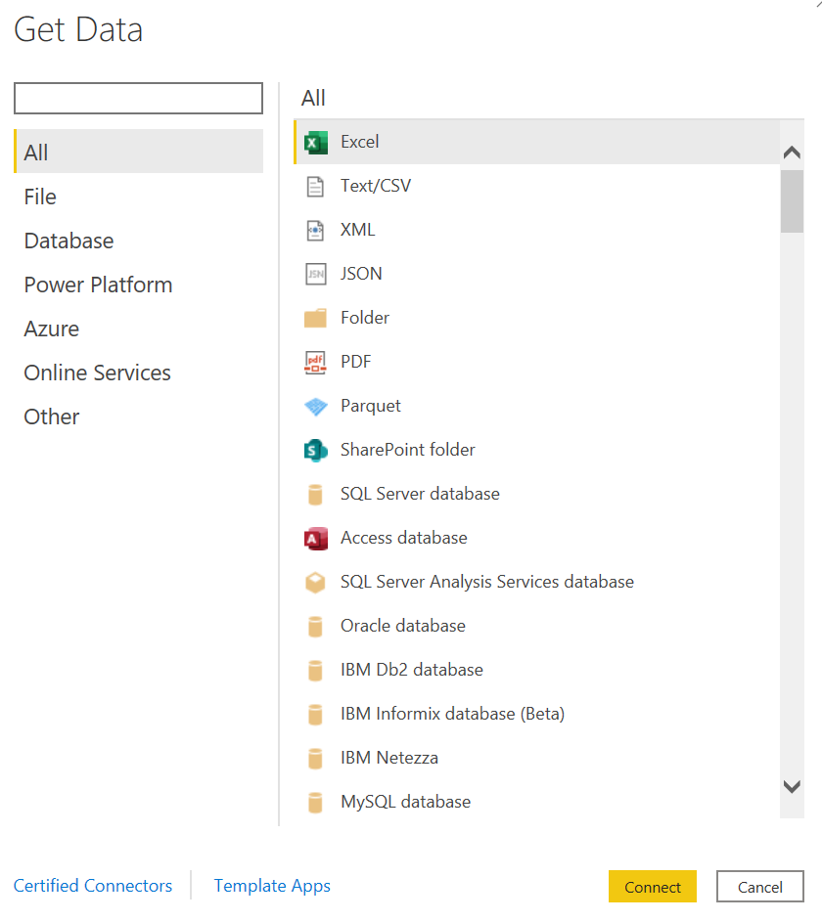
Connect to Data Source
Home Tab > Data Ribbon> Get data
Select the appropriate data connection
Enter credentials (if required)
Load data

Slide 40
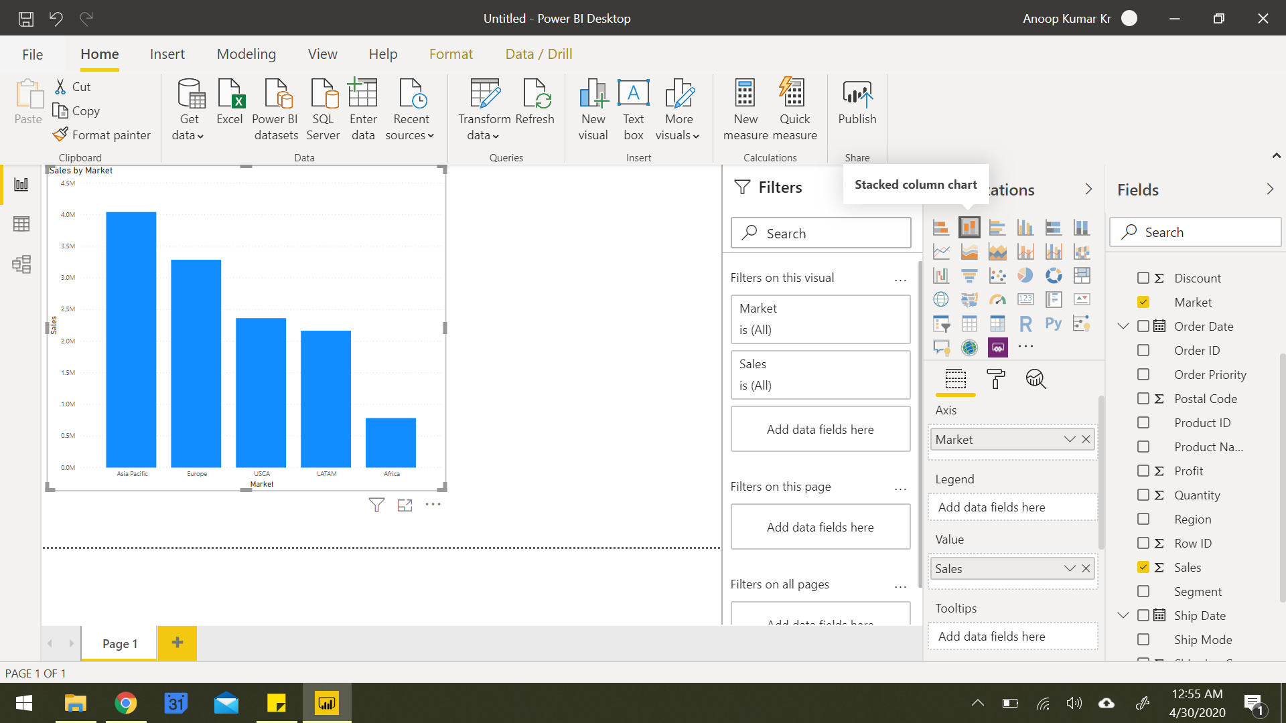
Build a Visualization
1. Understand Your Fields
In the Fields pane (right side), review your tables and columns.
Identify dimensions (categories like “Department”) and measures (quantities like “Sales” or “Salary”).
2. Choose Your Visualization
In Report View (center canvas):
Go to the Visualizations pane.
Click on a chart type (e.g., bar, line, pie, table, etc.).
A blank chart will appear on the canvas.

Slide 41
Build a Visualization
3. Drag and Drop Fields
Drag fields from the Fields pane to the appropriate areas in the Visualizations pane:
Axis / Legend / Category: For dimensions (e.g., Month, Department).
Values: For numerical data (e.g., Sales, Quantity).
Filters / Tooltips: For filtering or showing additional data on hover.
4. Format Your Chart
Use the Format tab (paint roller icon):
Adjust titles, colors, labels, gridlines, data labels, etc.
Toggle on/off legends, tooltips, and other elements.

Slide 42
Connect to file Employees.xlsx file
Load data from Employee sheet
Create Visualizations:
Card Chart: Total number of Employees
Bar Chart:. Average Salary by Department.
Line Chart: Number of employees joined per year.
Pie Chart: Employee count by department
Slicer: Gender
Q&A visual
Demo - Customizing theme, formatting visuals, formatting pages, drill up/down filters, edit interactions

Slide 43
Power BI Filters: What We’ve Learned So Far –
Cross-Filtering / Cross-Highlighting – Occurs when selecting a data point in one visual filters or highlights data in another.
Edit Interactions – A feature that lets you control how one visual affects others when selected (filter, highlight, or do nothing).
Found under the Format > Edit Interactions toolbar option.
Slicers – Interactive on-page filters users can click to filter multiple visuals at once.
Drill through Filters – Allow users to right-click a data point and navigate to a detail page with context carried over.
Visual-Level Filters – Apply to a single visual only. Other visuals are unaffected.
Page-Level Filters – Affect all visuals on the current report page.
Report-Level Filters – Apply across all report pages, useful for global filters like region or time period.

Slide 44
Power BI Styling Tools: What We’ve Learned So Far –
Customizing Theme
Themes control colors, fonts, backgrounds, and default styles for all visuals.
Access via: View > Themes
Formatting Visuals
Each visual can be individually styled using the Format pane.
Common options include:
Title: Text, size, alignment, and font.
Data labels: Show values on charts.
Legend: Show/hide, position, font, color.
Colors: Change bar/line/segment colors.
Tooltips: Customize hover-over info.
Borders & Backgrounds: Add emphasis or group visuals visually

Slide 45
Power BI Styling Tools: What We’ve Learned So Far –
Formatting Pages
Customize the layout and behavior of entire report pages.
Found under the Format > Page information or by clicking the empty canvas:
Page size: Switch between default, 16:9, letter, or custom dimensions.
Backgrounds: Add colors or images to the canvas (e.g., branded templates).
Canvas settings: Enable gridlines or snap-to-grid for visual alignment.

Slide 46
Introduction to Power Query Editor

Slide 47
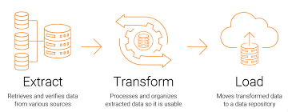
Overview of Power Query Editor
Tool for connecting, transforming, and shaping data.
Available in Power BI, Excel, and other Microsoft tools.
Generates M code automatically based on actions.
Interface split into Query Pane, Data Preview, and Applied Steps.
Data Source Connectivity
Connect to multiple sources: Excel, CSV, SQL Server, Web, APIs, SharePoint, etc.
Combine multiple queries using merge or append.
Use parameters and functions for dynamic data loads

Slide 48
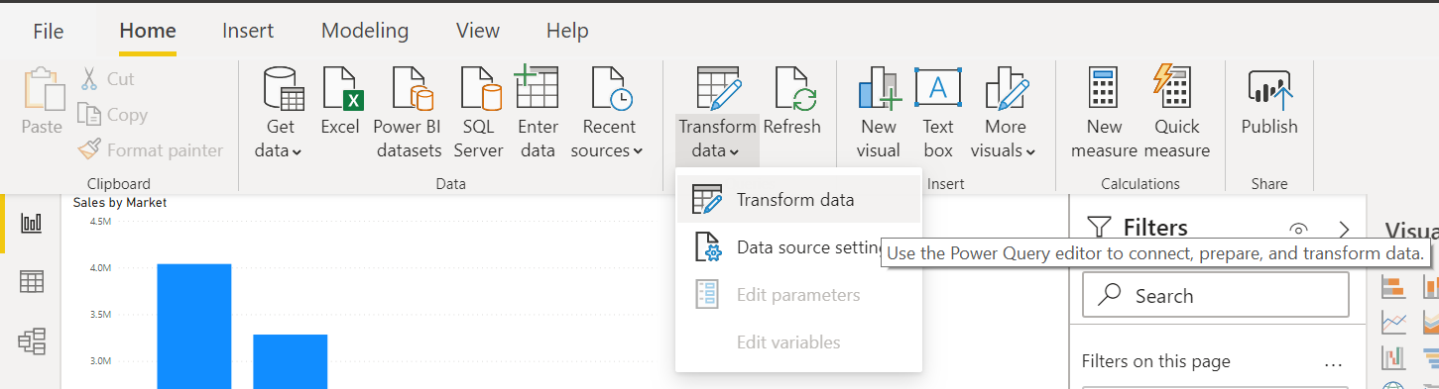
Launch Power Query Editor
Home Tab > Queries Ribbon > Transform data

Slide 49
Data Transformation Tools
Definition - Data transformation is the process of converting data from its raw form into a structured, usable format by applying operations like cleaning, reshaping, and enriching.
Purpose - It ensures data is consistent, accurate, and ready for analysis or reporting by correcting errors, standardizing formats, and structuring datasets.
Types of Transformations - Includes filtering, sorting, aggregating, splitting or merging columns, changing data types, and removing duplicates.
Use Case - Data Cleaning -
Fixing missing or incorrect values, removing duplicates, and standardizing formats to improve data quality.
Use Case - Data Integration -
Combining data from multiple sources (e.g., databases, spreadsheets) into a unified dataset for comprehensive analysis.
Use Case - Preparing Data for Visualization -
Transforming data to fit the needs of charts and dashboards, such as grouping or pivoting data for better insights.

Slide 50
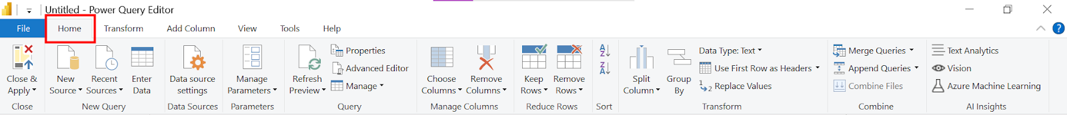
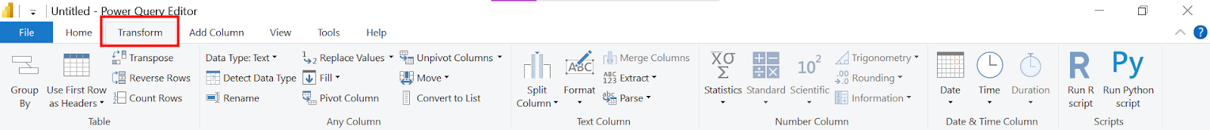
Power Query Editor – Interface
Home Tab - essential commands for data import, transformation, and query management.
Transform Tab - Contains tools to modify and clean your data, like changing data types, filtering, and splitting columns.

Slide 51
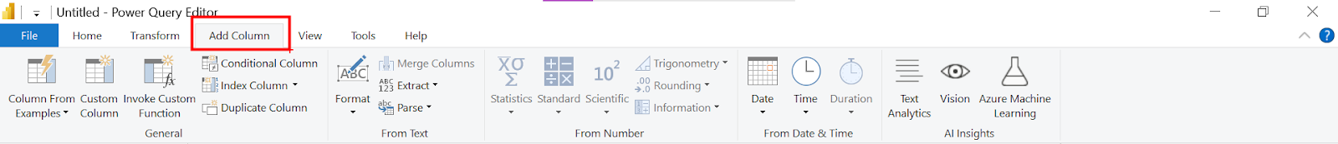
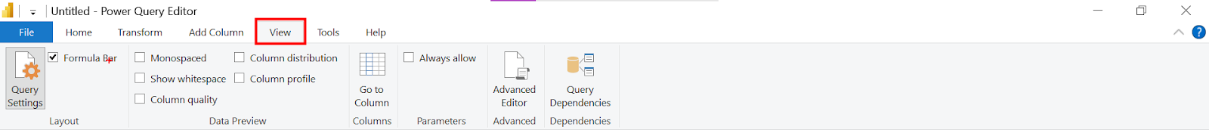
Power Query Editor – Interface
Add Column Tab - Allows you to create new columns based on calculations, conditions, or custom formulas.
View Tab - Offers options to manage the Power Query interface, such as viewing query dependencies, formula bar, and layout settings.

Slide 52
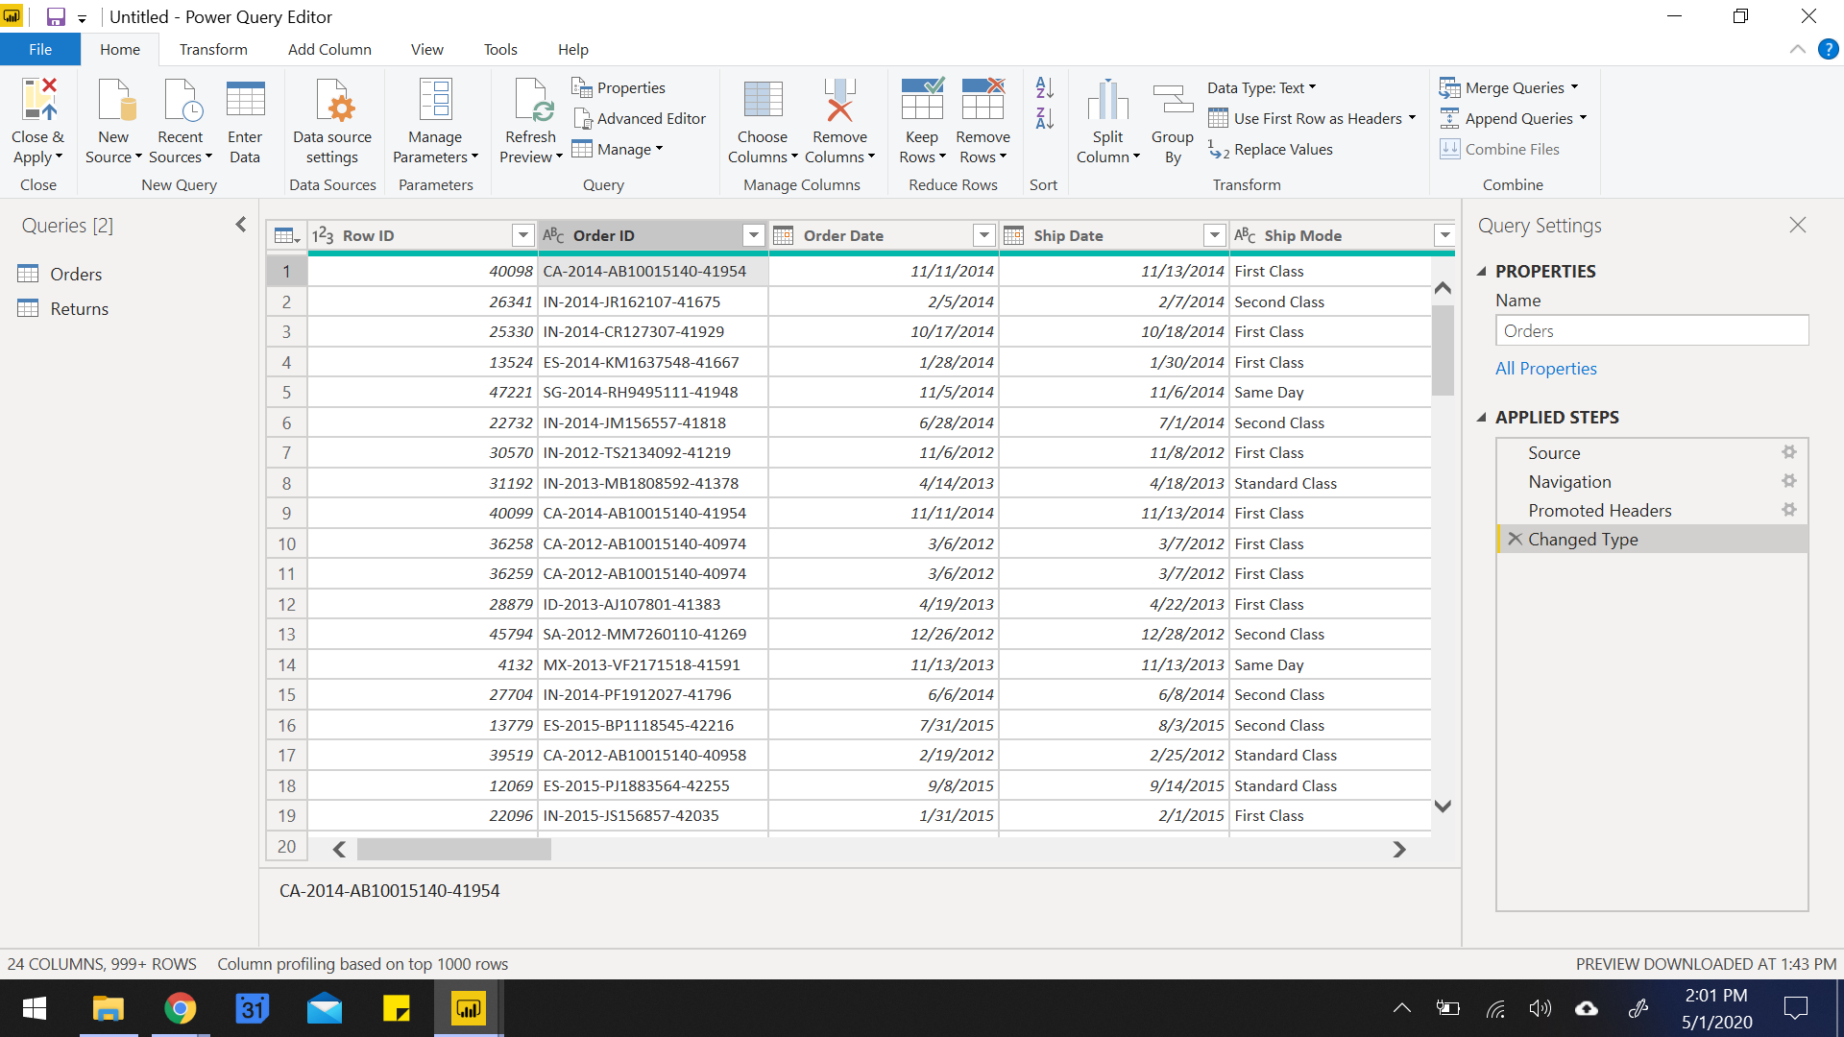
Power Query Editor – Interface
List of queries
Data preview of the selected sheet gets loaded

Slide 53
Power Query Editor – Interface
Renaming query
List of all the transformation steps applied on the data

Slide 54
Combining Tables with Append Queries
What is Append?
Appends = Stack rows from one or more tables into a single table.
When to Use It:
Combining monthly files, regional sales reports, or similar structured tables.
All tables should have matching columns (same names and order preferred).
How to Do It:
Go to Home > Append Queries (or "Append Queries as New").
Select the two or more tables you want to combine.
Result: One long table with all rows stacked.
⚠️ Tip: Columns that don’t match may create nulls or extra columns.

Slide 55
Combining Tables with Merge Queries
What is Merge?
Merges = Join data from two tables using a common key (like VLOOKUP).
When to Use It:
Adding customer info to orders.
Joining product master with sales data.
Enriching data from reference tables.
How to Do It:
Go to Home > Merge Queries (or "Merge Queries as New").
Select the two tables and matching columns (keys).
Choose Join Type:
Left Join (default): All rows from the first table, matched from the second.
Inner Join: Only matching rows from both.
Full Outer, Right Outer, Anti Joins, etc.
⚠️ Tip: After merging, click the expand icon (🔽) to select which columns to add from the second table.

Slide 56
Common Transformations in Power Query
Transformation | Description
First Row as Headers | Promotes the first row to be column headers.
Remove Columns | Delete unnecessary columns to clean the dataset.
Change Data Type | Convert columns to appropriate data types (e.g., date, number, text).
Split Column | Break a column by delimiter (e.g., comma, space) or number of characters.
Merge Columns | Combine two or more columns into a single column with a separator.
Trim/Clean Text | Remove extra spaces or non-printable characters from text data.
Fill Up/Down | Fill null values using values from above or below rows.
Replace Values | Substitute specific values with new ones (e.g., fix typos, unify names).
Transformation | Description
Date Transformation | Extract year, month, day, quarter, or calculate durations from date columns.
Text Transformation | Change case (upper/lower/proper), extract substrings, or format strings.
Add Conditional Column | Create logic-based columns (e.g., "High" if Sales > 500, else "Low").
Add Custom Column | Write simple formulas using M to create new fields.
Group By | Aggregate data (sum, average, count) by categories or IDs.
Column Profiling | View data quality, column distribution, and value statistics.
Transpose Table | Swap rows and columns for better alignment or reshaping data.
Unpivot Columns | Convert wide-format data to long format for analysis.

Slide 57
Merge vs Append in Power Query
Feature | Merge | Append
Purpose | Combine tables side-by-side using a key | Stack tables on top of each other
Structure | Tables may have different columns | Tables should have same columns/structure
Use Case | Lookups, enrich with customer/product data | Combine monthly, regional, or similar data sets
Action | Joins based on a common field (e.g., ID) | Adds rows from one table to another
Example | Add Customer Name to Order Data | Combine Jan, Feb, Mar sales tables
⚠️ Tip: Think of Merge as a VLOOKUP (horizontal) and Append as stacking files (vertical)

Slide 58
Data Tab

Slide 59
Data Tab
View Imported Data: The Data tab allows you to see the underlying dataset in a tabular format after it's loaded into Power BI.
Inspect and Validate: Users can verify data values, check for missing or incorrect data, and ensure data quality before using it in visuals.
Create Measures and Columns: You can write DAX formulas to create new measures, calculated columns, and quick measures directly from the Data tab.
Field Properties: Modify field names, data types, formatting, and data categories (like geographic fields or dates).
Preview Only – Not Editable: The Data tab doesn’t allow data editing (like Excel), but reflects all transformations done in Power Query.

Slide 60
Data Tab - Toolkit
Create and Edit DAX Calculations – Build measures, calculated columns, and calculated tables using DAX.
Format Fields – Change data type, decimal places, date/time format, currency symbols, etc.
Rename and Reorder Columns – Easily rename fields and adjust their display order in the Fields pane.
View Table Data – Explore and inspect loaded data row by row in tabular format.
Hide/Unhide Fields – Choose which fields to show or hide in the report view.
Sort Data by Column – Define custom sorting (e.g., sort Month Name by Month Number).
Define Hierarchies – Create hierarchies like Year > Quarter > Month for better drill-down visuals.
Set Data Categories – Tag columns as Geography, Web URL, Image URL, etc., for appropriate visual treatment.

Slide 61
Visualize data in Power BI

Slide 62
Power BI Report View
What is Report View?
The Report View is the main design workspace in Power BI Desktop where you create and arrange your visualizations (charts, tables, maps, etc.).
It appears as the middle icon (a bar chart symbol) in the left vertical pane.
Here you build the interactive report pages seen by end users.
Key Components on Report View:
Canvas: The large white area where visuals are placed and arranged.
Visualizations Pane: Contains all chart types and visual elements you can add.
Fields Pane: Shows tables and fields from your dataset, drag to add to visuals.
Filters Pane: To apply filters at visual, page, or report level.

Slide 63
Adding and Customizing Visualizations
How to add visuals:
Click any visualization icon (e.g., clustered bar chart, pie chart, line chart) in the Visualizations pane.
The visual placeholder appears on the canvas.
Drag fields from the Fields pane into the appropriate visual fields (e.g., Axis, Legend, Values).
Customizing visuals:
Use the Format pane (paint roller icon) to change colors, fonts, labels, titles, background, borders, and more.
Example: Change the bar colors to match corporate branding or add data labels for clarity.
Resize and reposition visuals by dragging edges or moving them on the canvas.

Slide 64
Using Filters and Slicers
Filters Pane:
Apply Visual-level filters to restrict data for a single visual.
Use Page-level filters to affect all visuals on the current page.
Use Report-level filters to apply across all report pages.
Slicers:
Add slicers from the Visualizations pane to create interactive filters users can manipulate.
Example: Add a slicer on "Year" so users can dynamically select the year to view.
Customize slicer style (dropdown, list, between values) in the Format pane.
Best Practice:
Use filters and slicers thoughtfully to give users control without overwhelming the report.

Slide 65
Bookmarks and Navigation for Interactive Reports
Bookmarks:
Bookmarks capture the current state of the report page — including filters, slicers, and visual settings.
Use bookmarks to create report stories, snapshots, or toggle views.
Example: Save a bookmark showing "Top 10 customers" or "Current month sales."
Buttons and Images for Navigation:
Insert Buttons (Home, Back, Reset, etc.) or Images via the Insert menu.
Assign Bookmark actions or Page navigation actions to these buttons/images.
This enables users to jump between views or pages smoothly, making the report more interactive.
Example:
Create a "Home" button that returns users to the main dashboard page.

Slide 66
Enhancing User Experience with Visual Elements
Using Images and Shapes:
Insert logos, icons, or shapes to brand your report and improve aesthetics.
Images can also act as clickable buttons with assigned actions.
Custom Buttons: Create custom navigation buttons and assign actions like:
Bookmark: Show/hide visuals or toggle filters.
Page Navigation: Move to other report pages.
Web URL: Link to external websites or documents.

Slide 67
Better User Experience
Keep navigation intuitive and consistent
Use clearly labeled buttons (e.g., “Home”, “Back”) and maintain their position across pages.
Use tooltips and button text to guide users
Enable tooltips for visuals and navigation elements to help users understand purpose without clutter.
Combine bookmarks and buttons
Create interactive reports where users can toggle views (e.g., show/hide visuals or switch between summaries and details).
Avoid clutter – less is more
Show only essential visuals on a page. Use bookmarks or drillthroughs to display more when needed.
Group and align visuals properly
Use the alignment tools to maintain visual consistency and a professional layout.
Use slicers for key filters
Empower users with slicers for commonly changed filters like date, region, or product category.
Use themes and color schemes wisely
Apply consistent color palettes (match brand guidelines) to improve readability and aesthetics.
Add a 'Reset Filters' or 'Clear Selection' button
Use bookmarks to return all slicers and filters to their default state, making exploration easier.

Slide 68
Ex. What is the total profit by each Product Category? (Use a bar chart)
Ex. How does Discount impact Profit? (Use a scatter plot)
Ex. What is the average Unit Price for each Product Sub-Category? (Use a column or bar chart)
Ex. What is the distribution of Sales across different Customer Segments? (Use a pie or bar chart)
Ex. What is the average Profit per Customer Segment? (Use a bar chart or box plot)
Ex. How does Shipping Cost vary by Region? (Use a bar chart or line chart)
Ex. What is the average Shipping Cost by Ship Mode? (Use a column chart)
Ex. What is the delivery time (days between Order Date and Ship Date) across Regions? (Use a box plot or line chart)
Ex. Which Product Sub-Categories have the highest Sales? (Use a horizontal bar chart)
Ex. Which Products are most profitable overall? (Use a top N bar chart)
Ex. How do monthly Sales and Profit trend over time? (Use a line chart or area chart with Order Date)

Slide 69
Power BI Service

Slide 70
Power BI Service
A cloud-based platform for sharing, collaborating, and interacting with Power BI reports and dashboards.
Key Features
Publish Reports from Power BI Desktop to the cloud
Create Dashboards by pinning visuals across multiple reports
Schedule Data Refresh for automatic updates
Collaborate with others via workspaces, apps, and sharing
Access Anywhere – use Power BI mobile app or web browser

Slide 71
Publish Your Work to Power BI Service
Share your reports and dashboards online with others in your organization.
Access from any device via browser or Power BI mobile app.
Set up scheduled refreshes to keep data up to date.
Steps to Publish –
Finish building your report in Power BI Desktop.
Click "Publish" on the Home ribbon.
Sign in with your Power BI account.
Choose a workspace (My Workspace or a shared one).Your report is now live on the Power BI Service!
Things to Remember –
You need a Power BI Pro or Premium license to share with others.
Make sure your data source supports refresh if needed.
You can manage dashboards, permissions, and alerts in the service.

Slide 72
Power BI Dashboard
A dashboard is a single-page, canvas view in Power BI Service that consolidates visuals from multiple reports, datasets, or apps.
Designed for monitoring KPIs and tracking insights at-a-glance.
Dashboards are only available in Power BI Service, not in Power BI Desktop.
Key Features
Feature | Description
Cross-report View | Visuals from different reports and datasets can be pinned together
Real-time Data | Tiles can be configured to auto-refresh in real-time
Alerts | Set up data-driven alerts on dashboard tiles (e.g., if a KPI crosses a threshold)
Q&A Support | Ask natural language questions, then pin the results
Mobile-Friendly | Dashboards are optimized for Power BI mobile apps
Sharing & Collaboration | Dashboards can be shared or published to apps/workspaces

Slide 73
Power BI Tiles
A tile is a single visual (chart, graph, card, map, etc.) pinned to a dashboard.
Tiles are the building blocks of a dashboard.
Tiles can come from:
Reports
Q&A results
Excel files
Images, videos, and web content
Types of Tiles
Visual tile: Pinned from a report
Q&A tile: Created using natural language queries
Image/video tile: Embedded media content
Web content tile: Embedded websites or HTML code
Live tile: Interactive tiles that reflect live report visuals
Tile Actions & Options
Pin: Add a report visual to a dashboard
Edit Details: Change title, subtitle, or hyperlink
Resize/Move: Adjust tile layout
Set Alerts: Get notified on data threshold changes
Open Underlying Report: Clicking tile takes user to source report

Slide 74
Dashboard vs Report
Feature | Dashboard | Report
Definition | A single-page summary with pinned visuals from one or more reports/datasets | A multi-page detailed view of data from a single dataset
Creation Tool | Created and edited in Power BI Service | Created and edited in Power BI Desktop
Pages | Single page (no scrolling) | Can have multiple pages
Interactivity | Limited (no slicers, basic interaction) | High interactivity (slicers, filters, drill-through, etc.)
Data Sources | Can use visuals from multiple datasets | Tied to a single dataset
Visuals | Pinned tiles (charts, KPIs, Q&A results, images, videos) | Full range of visualizations and custom visuals
Filtering | No visual-level filters or slicers | Full support for visual, page, and report-level filters
Use Case | High-level monitoring and KPIs | In-depth exploration and analysis
Mobile Optimization | Mobile-optimized layout supported | Also supports mobile layout customization
Alerts | Can set data-driven alerts on KPI or gauge tiles | Alerts not available directly
Drill-down/Drill-through | Not supported | Fully supported
Sharing | Shared via Power BI Apps or direct dashboard share | Shared via workspace or included in apps

Slide 75
AI Features in Power BI

Slide 76
AI Features in Power BI
1. Smart Narrative (Narrative Visuals)
Auto-generates text summaries for visuals or entire reports
Useful for automated insights, highlighting trends, key drivers, and anomalies
2. Q&A Visual
Allows users to ask natural language questions (e.g., "total sales by region")
Power BI interprets the query and generates visuals accordingly
Auto-suggests valid field names and values for better usability
3. Decomposition Tree
Breaks down metrics (like Sales) by multiple dimensions
Automatically surfaces key contributors to a value
Includes AI-driven "High Value" and "Low Value" options
4. Key Influencers Visual
Uses ML to identify what factors impact a given metric
Great for understanding drivers behind outcomes (e.g., what affects customer satisfaction)

Slide 77
AI Features in Power BI
5. Anomaly Detection
Detects outliers and unexpected data patterns in time-series visuals
Auto-explains anomalies with context and contributing factors
6. AutoML in Power BI Premium
Create machine learning models (like classification or regression) directly in Power BI using AutoML
No coding required – built on top of Azure Machine Learning
Can be used in Dataflows
7. Cognitive Services Integration
Use Azure Cognitive Services in Power BI for:
Text analytics (key phrases, sentiment)
Image tagging
Language detection
Available via AI Insights in Power Query
8. Quick Insights
Automatically analyzes datasets and provides instant insights
Uses AI to surface patterns, outliers, and trends
Pro Tip: Many AI features (like AutoML and Cognitive Services) require Power BI Premium or Premium per user (PPU) licensing.

